Slide 1
SharePoint
Connect and empower your organisation
Stefanie Kechayas – Senior Consultant
17 November 2015

Slide 2
Today
          What is SharePoint?
          Why use SharePoint?
            Some examples
          Alternatives/complimentary systems
          Best practice and important things to remember
Notes:
Today’s session is a deep dive into SharePoint – which is one of the more complex and biggest features of the Office 365 offering to NFPs
Sharepoint is a very comprehensive system that can be heavily developed and customised to be a pretty big, and expensive beast, especially on-premesis. This Webinar wil NOT go there – this webinar is focussed on how NFPs and smaller organisations, who are not interested or can’t invest in extensive server farms to host their intranets can benefit from the SharePOint Online features – FREE for NFP.
This presentation is about what you need to think about early on before you start ‘doing sharepoint “ – I’ve seemclients go ‘head-first’ and it can be problematic – this has tips that I think anyone should think about first before they start

Slide 3
What is SharePoint?

Slide 4
SharePoint is the system that organisations use to build secure internal websites – intranets.
Once used by big organisations as their intranet platform or content management system (CMS), and it was a server (on premises) product.
Now it’s available online as part of the Office 365 suite.
  You need an Office 365 subscription to access SharePoint Online sites.
  Accessed via a web browser, such as Internet Explorer, Chrome or Firefox.
You can use it as a secure place to store, organise, share, and access information from almost any device.

Slide 5
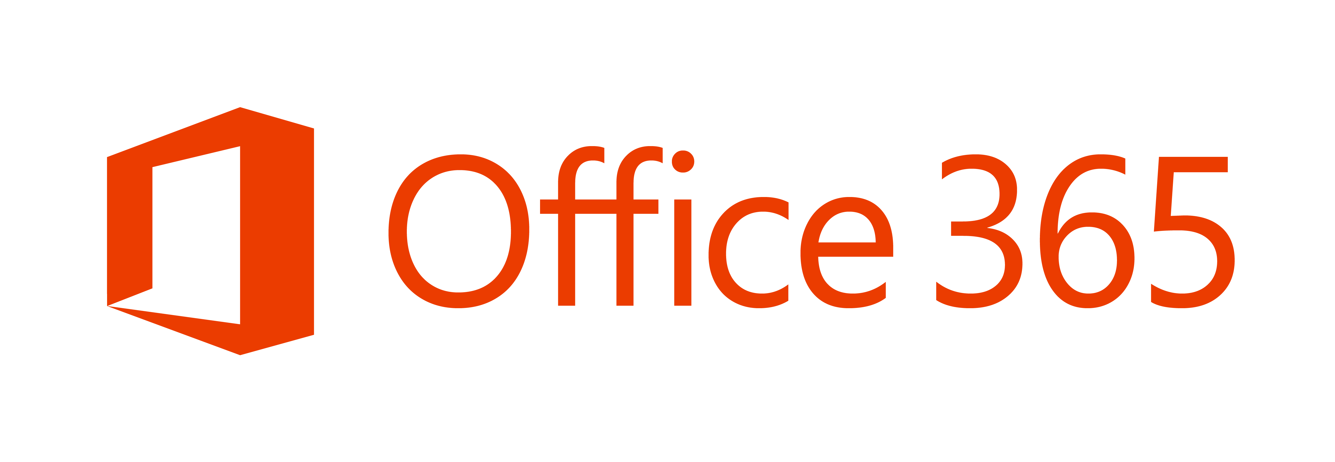


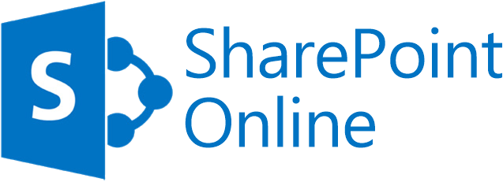



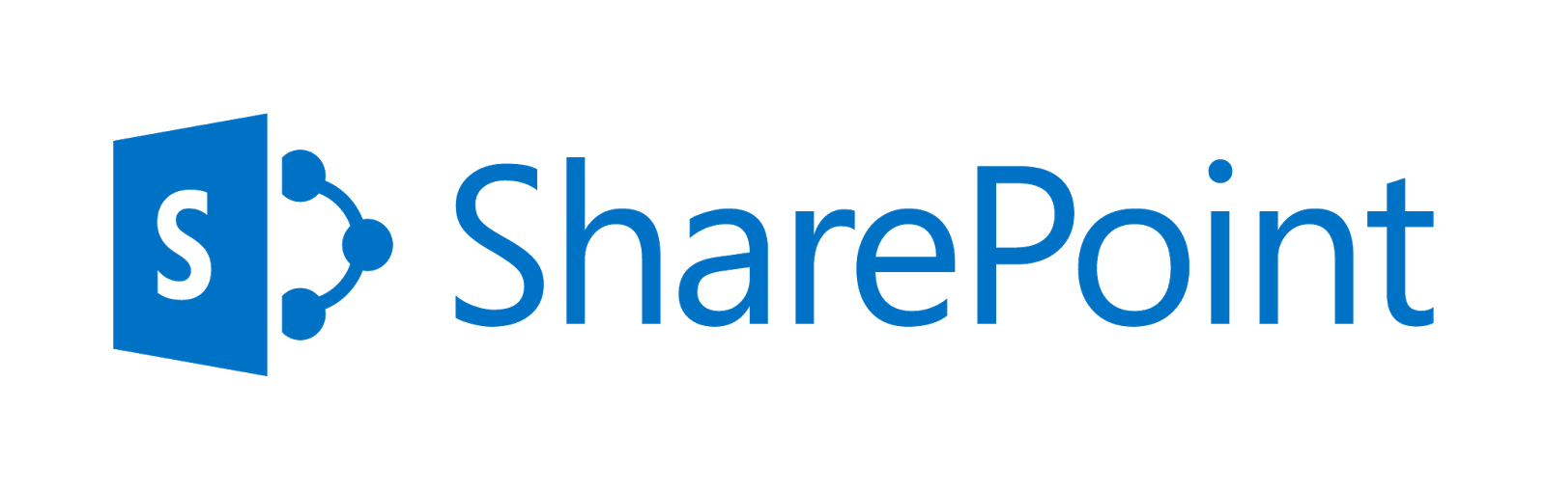
Notes:
Whilst SP used to be a server only product, which was expensive and took a lot of maintenance, there is now SP ONLINE – a cloud version of SharePoint
SP Online is now one part of the wider Office 365 suite – and NFPs get it for free

Slide 6
Cloud-based:
Intranet
Document management
Team sites
Notes:
Whilst SP used to be a server only product, which was expensive and took a lot of maintenance, there is now SP ONLINE – a cloud version of SharePoint
SP Online is now one part of the wider Office 365 suite – and NFPs get it for free

Slide 7
Why use SharePoint?

Slide 8
SharePoint does…
Intranet – Serves as the platform for organisation’s internal homepage, a central hub of useful information and communication for businesses.
Document management – Provides sophisticated document libraries for storing and working on documents.
Team sites – Supports teams working on projects together by providing a centralised spot for tasks, calendars, documents, links and other useful tools.
Notes:
SharePoint can do *A LOT* - but primarily, it does three things REALLY well, mostly out of the box. This is what most Orgs use it for…
Intranets are good for:
Reducing email, streamlining and standardising internal communications and finding info like staff lists, policies etc
Document management
Is good for version control, minimising duplicate documents, and co-authoring
Team sites
Keep all project ot team related content together, also great to be easily accessible across the entire business

Slide 9
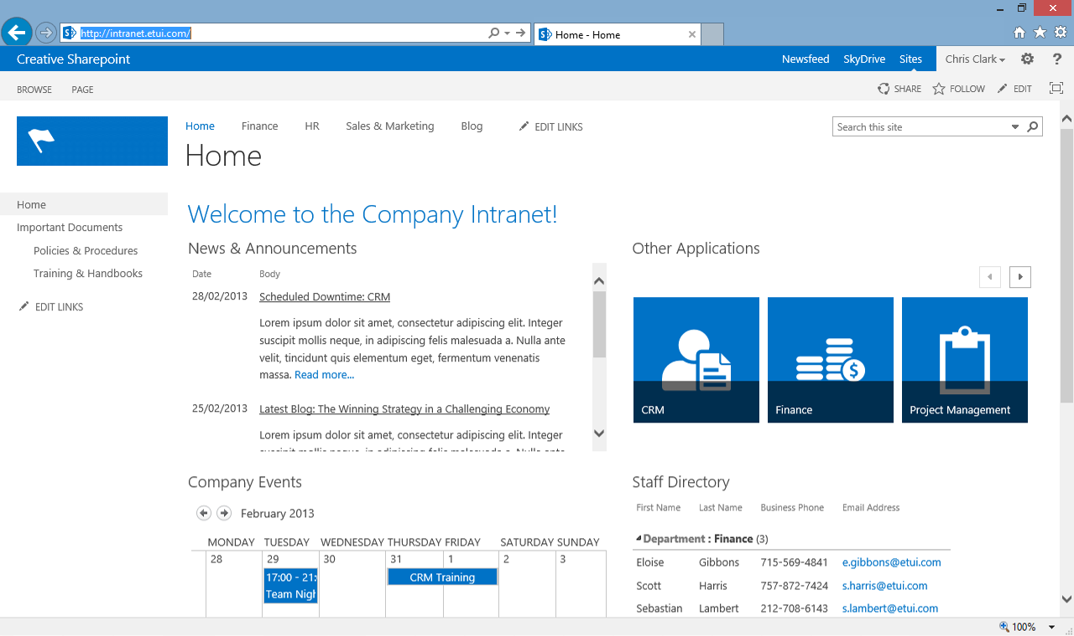
Intranet

Slide 10
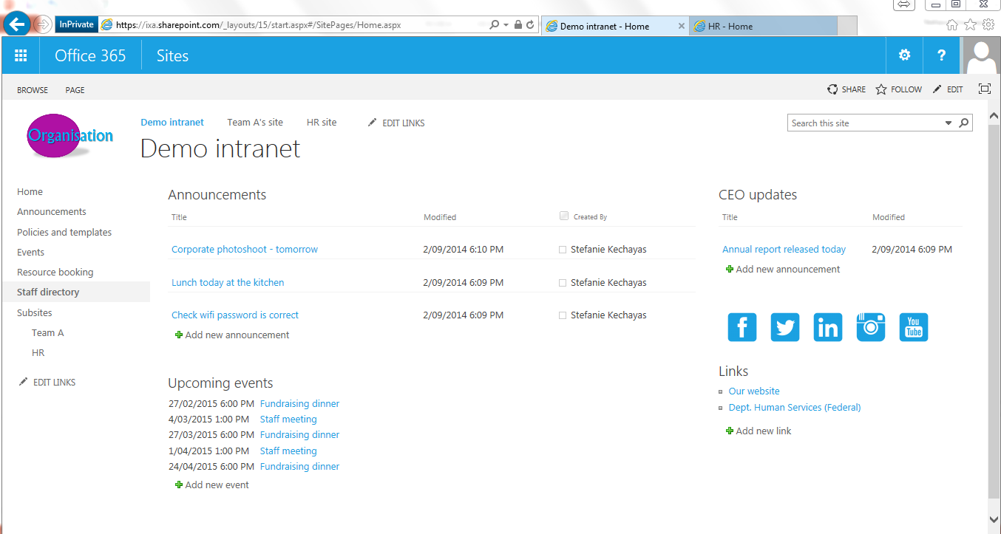
Intranet

Slide 11
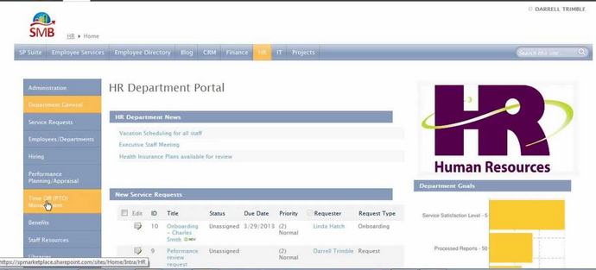
Intranet

Slide 12
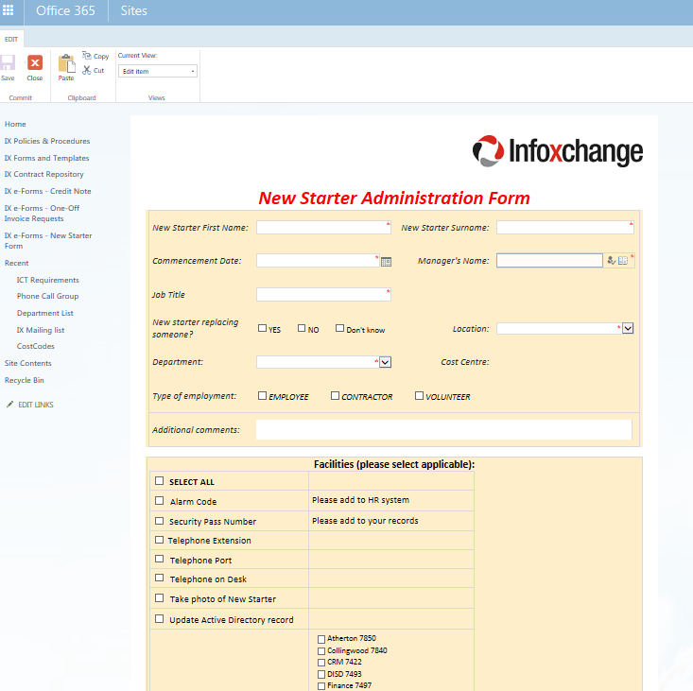
Intranet - forms

Slide 13
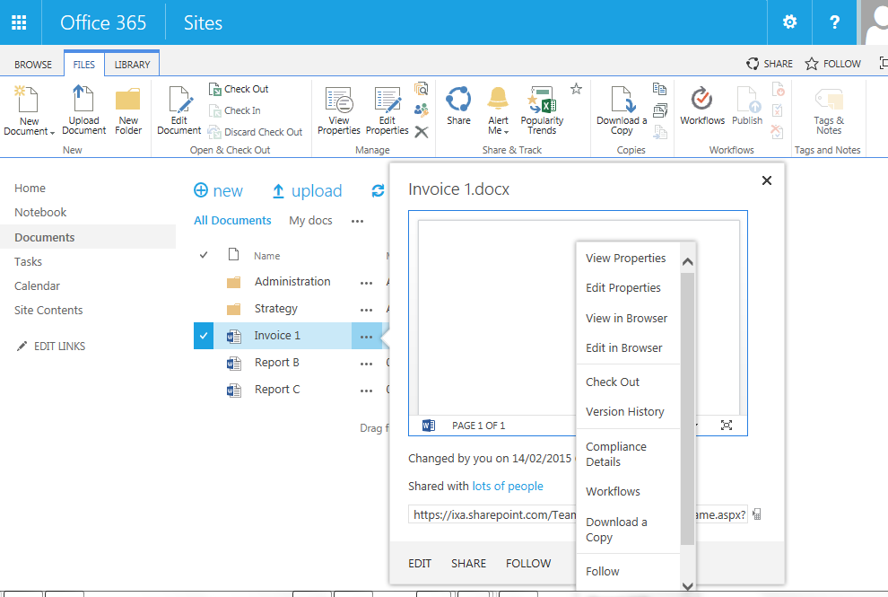
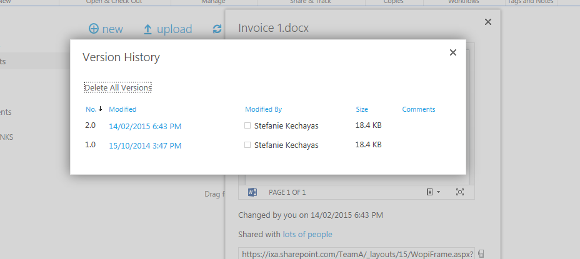
Document management – version control
Notes:
Version control and document features

Slide 14
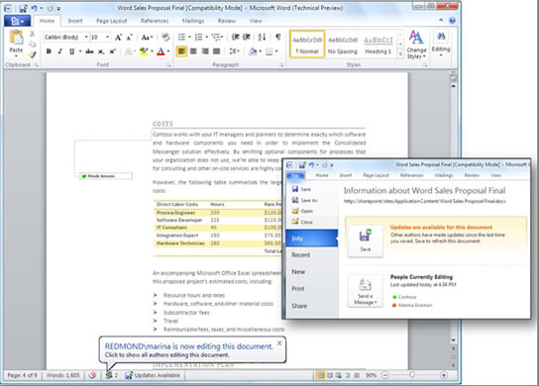
Document management – Co-authoring
Notes:
Co-authoring

Slide 15
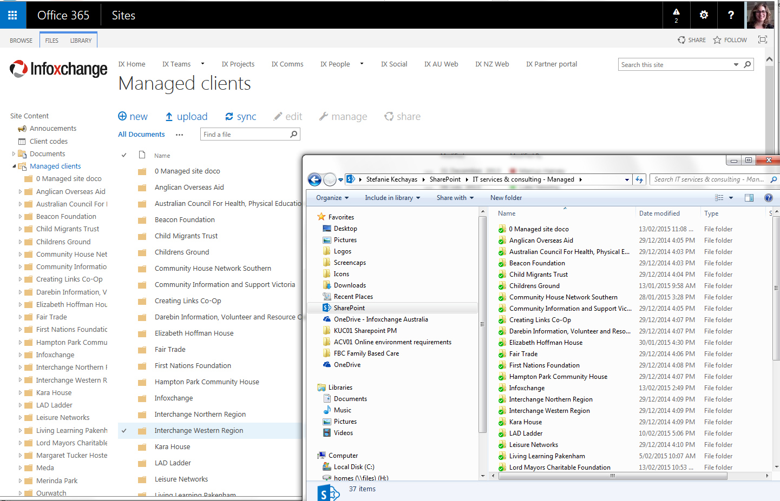
Document management – Offline syncing (use with caution)
Notes:
Co-authoring

Slide 16
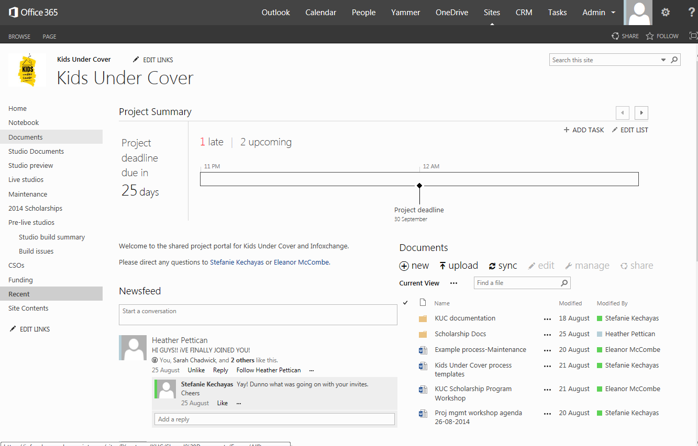
Team collaboration

Slide 17
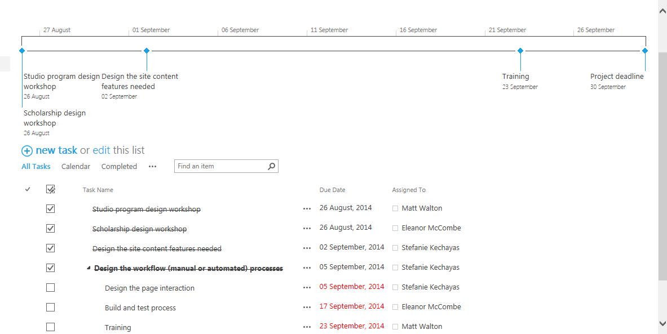
Team collaboration

Slide 18
Alternatives and other tools
Notes:
SharePoint can work in tandem with other Microsoft products pretty seamlessly

Slide 19

Notes:
Back to this slide, you’ll recall that in O365 you get more than just SharePoint

Slide 20
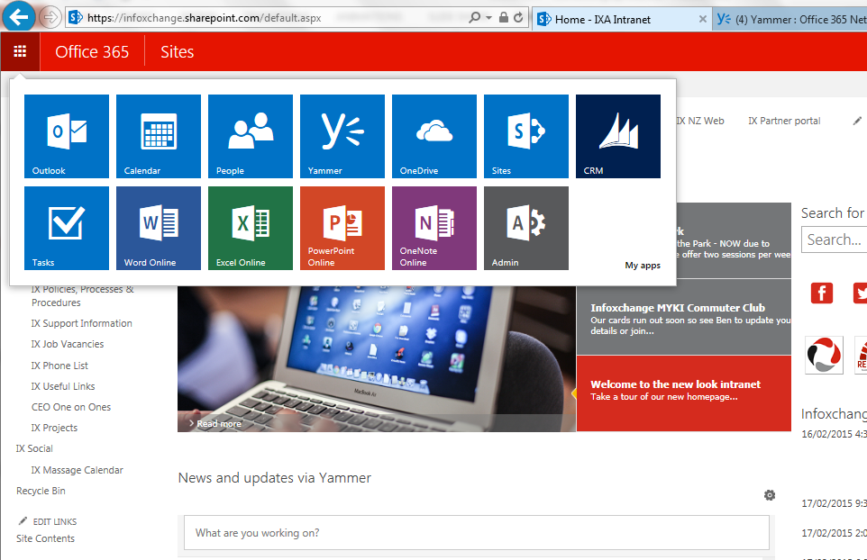
The full suite

Slide 21
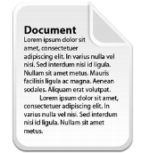
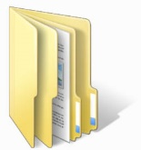
SharePoint vs OneDrive
10GB + .5gb per license (free), expandable ($)
Store files, calendars, contacts, and more
Data is centrally managed, intended for shared files
1 TB Per User (free)
Not Expandable
Every file is “owned” by a user, not intended for shared files
Files can be taken Offline with OneDrive Desktop Client
Notes:
Differences between SharePoint libraries ad OD 4 B

Slide 22
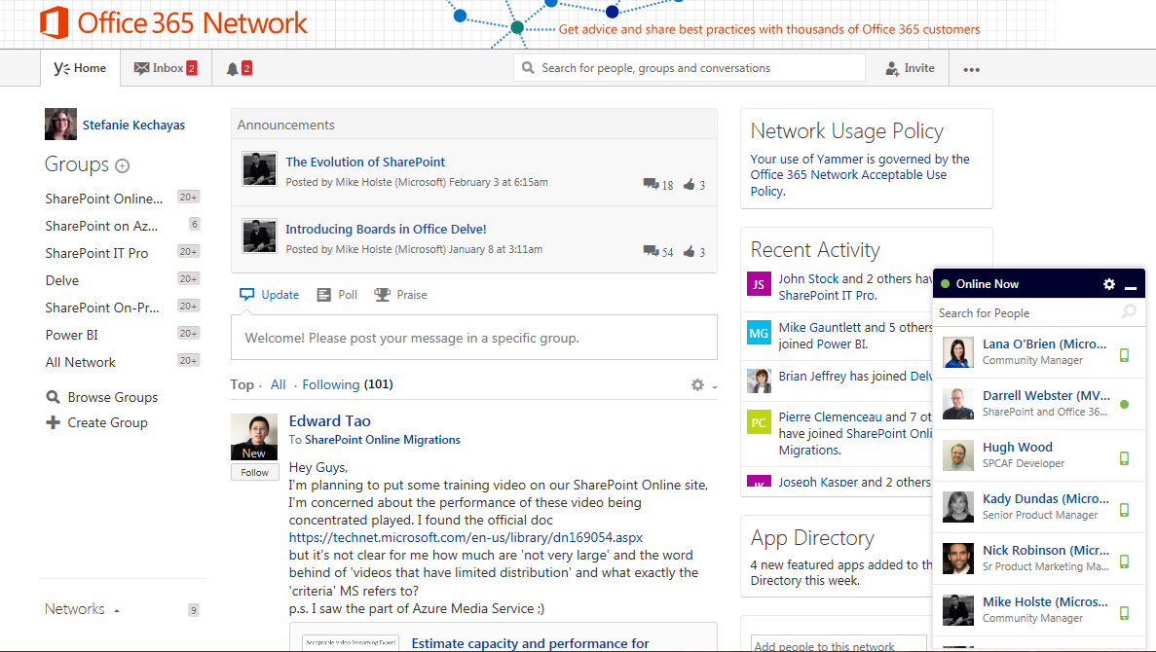
Yammer
The enterprise social network
Notes:
Yammer is an Enterprise social network tool – it was funded in 2008 and Microsoft acquired it in 2012.
Think of it as like a business FaceBook.
It’s GREAT for communications, and there’s a mobile app –

Slide 23
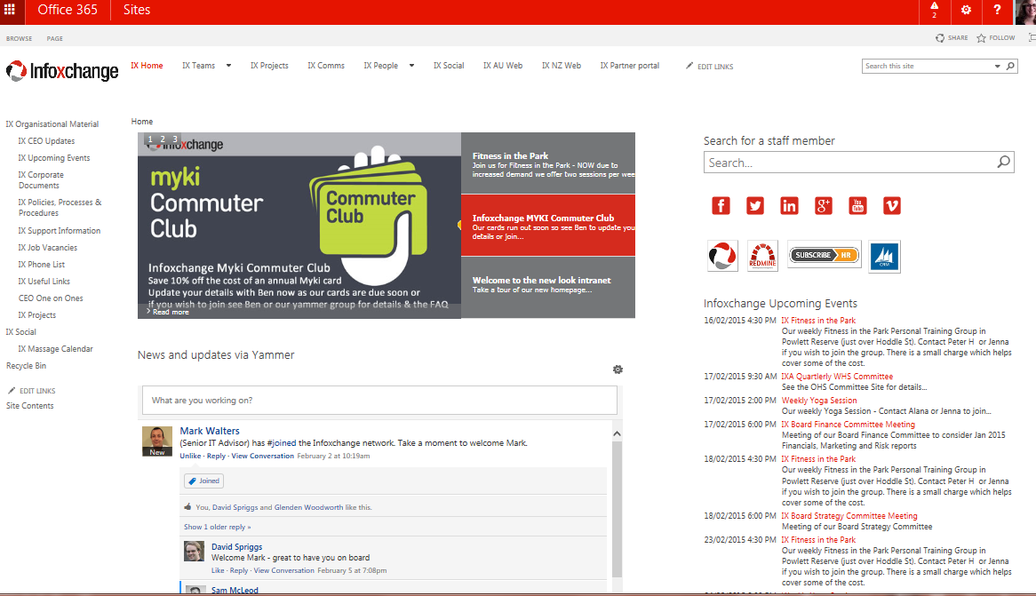
Yammer

Slide 24
Best practice and things to keep in mind
Strategy
Implementation
Design
Governance

Slide 25
Strategy: Why do you need or want SharePoint?
Is an intranet the best tool to solve your problem?
Are you ready, culturally, for this new way of working and communicating?
You need to be able to clearly articulate:
What is the purpose of SharePoint for your organisation?
Notes:
Deciding factors:
Bad efficiencies and frustrations
Size
Locations
Only when you have a clear purpose can you tackle an intranet project. They easily fail because the scope is too ‘wooly’

Slide 26
Implementation: How will you do it?
          Do you have the capability and capacity internally to implement SharePoint?
          Do you need an external partner to help?
          Who will manage the intranet or libraries going forward?
Notes:
Things to

Slide 27
Design: What will your information architecture be?
Top level sites often used for classic intranet content eg announcements, policies, phone lists
Home site
Site collection
Programs
Subsite
Fundraising and communications
Subsite
Corporate services
Subsite
Program 1
Library
Program 2
Library
Program 3
Library
General
Library
Calendar
List
Links
List
Brand refresh project
subsites
Tasks
List
Documents
Library
Department or Project subsites for grouping content in meaningful functions
Lists and document libraries grouped under sites for shared teams.
Project-specific subsites for one-off project teams to use

Slide 28
Governance: What permission and access strategy will you use?
          Only lock down what has to be locked down for good reason (confidentiality, sensitivity).
          Establish clear lines of responsibility and access for content.
          Think about the practicalities and administrative overhead of maintaining rigid silos across the business.
Notes:
SharePoint environment can often be a radical shift in the way organisations work – the whole philosophy is to have an organization that is accessible to all, and that everyone can collaborate across boundaries – sometimes this requires a real shift in thinking from “this is my work area” to “this is Our work area”

Slide 29
Still thinking of implementing SharePoint?
          Define its purpose
          Audit your current systems and information architecture
          Assign people to lead and own the project
          Consider the cultural implications of a more shared approach to information
Notes:
Four big questions or things to consider up front before starting SP – often driven by one thing (eg, we need policies and forms) – defining purpose means interrogating that original need – is SP the right tool

Slide 30
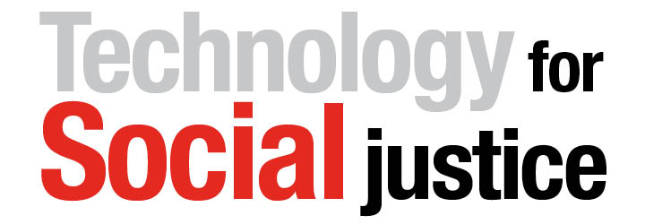
Questions and discussion…..
Infoxchange is a not-for-profit social enterprise dedicated to
Our objectives:
Increase Digital Inclusion by assisting all those in our communities to access and efficiently use ICT
Raise the level of Digital Proficiency and improve the efficiency and effectiveness of the community focused sector through Information and Communication Technology
Advocate for and showcase the benefits of
Digital Empowerment in our communities
Our services for the sector include……
IT plans, assessments & IT strategy development
Office 365, website & intranet services
Cloud, infrastructure & desktop services
Client & case management and service co-ordination solutions
CRM for non-profits
Contact: skechayas@infoxchange.org @stefanitza

Slide 31
What about privacy & security?
  Strong security & privacy controls
  http://office.microsoft.com/en-us/business/office-365-trust-center-cloud-computing-security-FX103030390.aspx
  Strong Privacy controls: ISO 27001, EU model clauses, HIPAA BAA & FISMA accredited
  http://office.microsoft.com/en-us/business/office-365-trust-center-top-10-trust-tenets-cloud-security-and-privacy-FX104029824.aspx#complianceStandards
  You own and retain all rights to your data
  http://office.microsoft.com/en-us/business/office-365-trust-center-top-10-trust-tenets-cloud-security-and-privacy-FX104029824.aspx#securityAndPrivacy
  By March 2015 all Australian customers will be hosted in the Australian Microsoft data centres in Sydney and Melbourne
  Many organisations (including Qld government) have chosen to use Office 365
  Its suitability depends on what information you intend to store and your funding agreements
Notes:
Evaluating the suitability of Office 365 is for your organisation, one of the key aspects to consider is information privacy and security. Deciding whether you should store information in the Cloud is critical
The Cloud offers many organisations significant benefits, but is not right for everyone, and each organisation needs to make an individual decision weighing up the potential benefits and risks when compared to their current environment. Ensuring compliance with local regulations is a responsibility for each non-profit, and the Office 365 Trust centre is an excellent resource to help you understand the privacy and security controls that are in place and to make an informed decision.
Whether Office 365 is right for you depends on the type of information you store, your local laws and your contract obligations from your funders. When considering whether Office 365 is appropriate for your organisation, you should consider :
How sensitive is the data that you are considering storing in the Cloud & offshore:
Sporting clubs, organisations providing family services & health clinics are all likely to answer this question differently.
The jurisdictions you operate in, and any relevant guidance. This may include guidance from a privacy commissioner (if applicable), conditions around the storage of health data, etc
Are there any funding requirements or conditions on your existing grants and service delivery contracts that should be considered?
What protections do you have today against loss, misuse & disclosure. (e.g. from theft, flood, unauthorised access or inadvertent disclosure, etc)
Some organisations have strong password controls on user accounts & mobile devices, offsite backups & physically secure servers. Other organisations may share passwords, have servers that are well out of warranty and not physically secured or have a risky approach to regularly storing a copy of data off-site.
Consider whether controls would be stronger or weaker using the cloud for your organisation
Will moving to the cloud save money, make it easier for staff to work, or reduce your risk?
Migration to the Cloud should be assessed through a risk management lens which balances risks and benefits
Many community development organisations have made the decision to store their information in a secure Cloud environment. It is less usual that organisations store personal health-related information overseas. Organisation such as Queensland Government, Police, Infoxchange and several of the large not for profits are migrating to Office 365.
Office 365 is accredited to many international security standards - ISO 27001, European Union model clauses the US Federal Information Security Management Act and others
Microsoft provides details about where your data is stored in our data maps and have a lot of information in the trust centre -
Take a look at who can access your information and under what circumstances it can be accessed.
As an Office 365 administrator, you can choose to receive notifications regarding datacenter location changes, as well as security, privacy, and audit information.

Slide 32

Office 365 Resources – for more information
Office 365 for nonprofits: www.microsoft.com/office365nonprofits
E1 vs. E3 plan: http://office.microsoft.com/en-au/business/compare-office-365-for-business-plans-FX102918419.aspx
(Click on the ‘Enterprise’ tab)
Australian Privacy Principles
http://www.oaic.gov.au/privacy/privacy-resources/privacy-guides/app-quick-reference-tool
  New Zealand Privacy Guidance on Cloud Computing http://privacy.org.nz/assets/Files/Brochures-and-pamphlets-and-pubs/OPC-Cloud-Computing-guidance-February-2013.pdf & Microsoft’s answers:
  http://blogs.msdn.com/cfs-filesystemfile.ashx/__key/communityserver-components-postattachments/00-10-41-34-76/Standard-Response-to-OPC-Cloud-Computing-Checklist-for-Office-365-_2D00_-24-April-2013.pdf
The Microsoft Trust Centre – Privacy, Security & actual availability information
http://office.microsoft.com/en-us/business/office-365-trust-center-cloud-computing-security-FX103030390.aspx
- ImproveIT.org
Resources to help your organisation get the most from your technology investment
Notes:
For more information, we’ve listed some valuable online resources for you:
1/ Office 365 for nonprofits - www.microsoft.com/office365nonprofits - this also includes further information on eligibility requirements.
2/ To read further advice about an Office 365 rollout, you can read the admin rollout guide
3/ The User Adoption Learning Center provides both high level, information for when you first get started on Office 365, and then specific product information across the different products you have access to through Office 365.
5/ The Microsoft Trust Center provides a wealth of valuable, easy to understand information about privacy and security related to Office 365

Slide 33
Additional Office 365 Support available
Office 365 readiness assessments
offered in partnership with Connecting Up & TechSoup NZ:
  AU - http://www.connectingup.org/office365
  NZ - https://www.techsoup.net.nz/office365
Office 365 DIY workshops
Additional ConnectingUp webinars including a practical demonstration.
Implementation services and migration advice
SharePoint configuration and development
Contact skechayas@Infoxchange.org or (03) 9418 7471 or @stefanitza

